Slide 1
NameSpace
The Big Idea for Globalization
Service-Oriented Software Engineering
Software Institute
Nanjing University
Bei Jia

Slide 2
Problem: Element and Attribute Names can be Ambiguous
Consider the following XML document:
How does an application know that:
  The first occurrence of title is a book title.
  The second occurrence of title is a person's title.
Need a way to eliminate the ambiguity for the purpose of processing.

Slide 3
Elaboration
Some possibilities:
  Adopt industry standard document formats and naming conventions
    Problems: No industry is an island, industries interact
    This approach works at the document level, a good example is ebXML (http://www.openapplications.org), Naming standards down to the element/attribute level are too brittle
  Use verbose element names, that is, bookTitle, courtesyTitle
    Problem: naming becomes fundamentally difficult, there is no way to know if a name is already in use, further, the data and/or its model may not belong to the consuming application.
  Use some name qualifier that is already established as unique, that is, a domain name qualified URI.
    Domain names are already managed and maintained as unique. This approach has promise and was developed into XML Namespaces.

Slide 4
Namespaces: The Big Idea
In concept, each element name and attribute name could be expressed as: URI+name, for example, <title> might become:
There are two problems with this format:
  It is not well-formed XML under the 1.0 specification.
  It is a lot of typing.
If it were possible to create a synonym for the URI and replace occurrences of the URI with that synonym, the amount of typing would be reduced and, if handled correctly, the result would be compatible with XML 1.0
This concept forms the basis of the XML Namespace specification.

Slide 5
XML Namespaces
For the purposes of XML namespaces, URIs are considered identical when they match character for character. If URIs are different, they represent different Namespaces.
  Note: There is no network lookup associated with the use of URIs in this specification, it is a lexical convention only.
The Namespace specification deals with the mechanics of associating a URI qualifier (aka namespace) with element and attribute names to create two-part names that are unique and free of ambiguity.

Slide 6
Qualified Names (QNames)
QNames are used in place of element and attribute names.
QNames have a prefix and a local part - they look like this:
At all times, the prefix should be thought of as shorthand for the actual URI/namespace. That is, the above is really:

Slide 7
Declaring Namespaces (1/2)
The syntax of a namespace declaration is:
The following example declares the namespace http://www.library.com/books, assigns it a prefix of 'books' and identifies the book element as a member of that namespace.
Attributes may also belong to a namespace. As with elements, attributes are prefixed as follows:

Slide 8
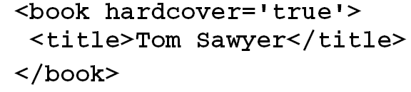
Declaring Namespaces (2/2)
Suppose a document without namespaces looked like:
One way to use a namespace is:
It is clear that declaring the namespace on every single element becomes unwieldy (and error prone).

Slide 9
Namespace Scope
When a namespace prefix is declared, it remains in scope for:
  Attributes of the element where it is declared.
  Child elements (and their attributes) of the element where it is declared.
  Unless the prefix is redefined on a nested element.
QNames are still required, the namespace is not assumed.
Applying this technique, the previous example becomes:

Slide 10
Default Namespaces
For situations where a majority of elements are associated with the same Namespace, a default namespace may be declared.
QNames are used to identify nested elements that are from a different namespace.
The default may be respecified for each element scope
  Nesting is respected, that is, respecification does not influence the outerscope containing the nested elements.
Default namespaces don't apply to attributes. Attributes have no namespace unless their names are qualified.

Slide 11
Example - Default Namespaces

Slide 12
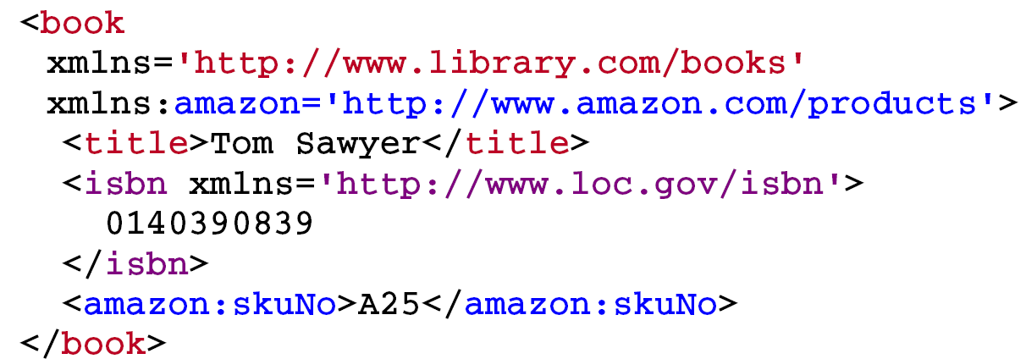
Documents with Multiple Namespaces
Document with three namespaces:
Note the variations in the form of the namespace declaration.

Slide 13
Elements with No Namespace
What happens to the previous example with no default namespace?
The xmlns="" syntax resets the default namespace for the scope in which it occurs. The <isbn> element is not in a namespace.

Slide 14
Attributes and Namespaces
Attributes are not affected by a default namespace declaration.
Attributes on a single element must be unique.

Slide 15
Example: Use of Namespaces
Composition of a particular airplane in an airline fleet:

Slide 16
More Information

